Slide 1




NEXT GEN EMPLOYABILITY PROGRAM
Creating a future-ready workforce
Team Members
College Name
Student Name : D. Esther
Student ID : au960221104054
Arunachala college of Engineering for women

Slide 2

CAPSTONE PROJECT SHOWCASE
Project Title
Car Rentals Application with Django Framework
Abstract | Problem Statement | Project Overview | Proposed Solution | Technology Used | Modelling & Results | Conclusion

Slide 3
Abstract The proposed car rental application aims to streamline the process of renting vehicles by providing users with an intuitive and efficient platform. Built on the Django framework, which is renowned for its simplicity, scalability, and robustness, the application offers a comprehensive suite of features to cater to the diverse needs of both customers and administrators. Car rental services are one such domain that has witnessed a significant surge in demand due to its convenience and flexibility. This abstract presents the design and development of a web-based car rental application using the Django framework.
Source :

Slide 4
Problem Statement To address this problem, the development of a comprehensive car rental application using the Django framework is proposed. This application aims to revolutionize the way car rentals are conducted by offering a seamless and intuitive platform that enhances accessibility, convenience, and efficiency for all stakeholders involved. Car rental services play a crucial role in providing individuals and businesses with flexible mobility options. However, the traditional process of renting vehicles often involves tedious paperwork, manual booking systems, and limited accessibility, leading to inefficiencies and frustrations for both customers and rental companies.
Source :

Slide 5
Project Overview Develop a user-friendly web application for car rentals using the Django framework. Implement robust authentication and authorization mechanisms to ensure data security. Provide a comprehensive catalog of vehicles with detailed information for users to make informed decisions. Streamline the booking process, handling availability checks and generating booking confirmations. Integrate popular payment gateways for secure online transactions. Design a powerful admin dashboard for efficient fleet management and analytics. Enable users to leave feedback and ratings for rental vehicles.
Source :

Slide 6
Proposed Solution The application will offer a user-friendly platform for renting vehicles, integrating essential features for both customers and administrators to streamline the rental process and enhance overall user experience. It involves developing a comprehensive car rental application using the Django framework, a high-level Python web framework known for its simplicity, scalability, and rapid development capabilities. Components: 1. User Authentication and Authorization: Django's built-in authentication system or integrate third-party authentication services for user convenience.
.
Source :

Slide 7
2.Vehicle Listings:
Develop a dynamic catalog of available vehicles, categorizing them based on make, model, and other attributes.
3.Booking System:
Design an intuitive booking interface for users to search for available vehicles and make reservations.
4.Reviews and Ratings:
Enable users to leave reviews and ratings for vehicles they have rented, contributing to the credibility and transparency of the rental service.
5.Payment Gateway Integration:
payment processing functionalities for users to make rental payments using credit/debit cards or other payment methods.
Source :

Slide 8
6.Admin Dashboard:
Develop a robust admin dashboard for administrators to manage various aspects of the rental application.
Provide functionalities for monitoring bookings, managing user accounts, and generating reports.
7.Notification System:
Implement a notification system to keep users informed about booking confirmations, reminders, and updates.
Source :

Slide 9


Technology Used
Front-end
Back-end
Source :

Slide 10
Modelling & Results Modelling Approach: Database Schema Design: Utilize Django's built-in ORM (Object-Relational Mapping) to define models representing entities such as Users, Vehicles, Bookings, and Reviews. Expected Results: 1.User-Friendly Interface 2.Efficient Booking Process 3.Secure Payment Processing 4.Transparent Feedback System
Source :

Slide 11
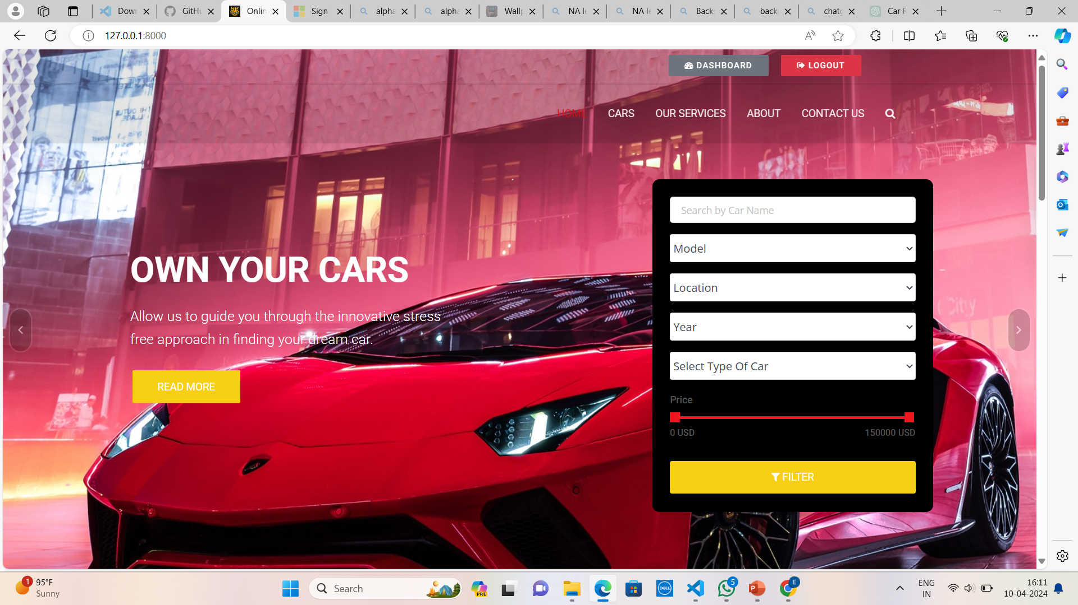
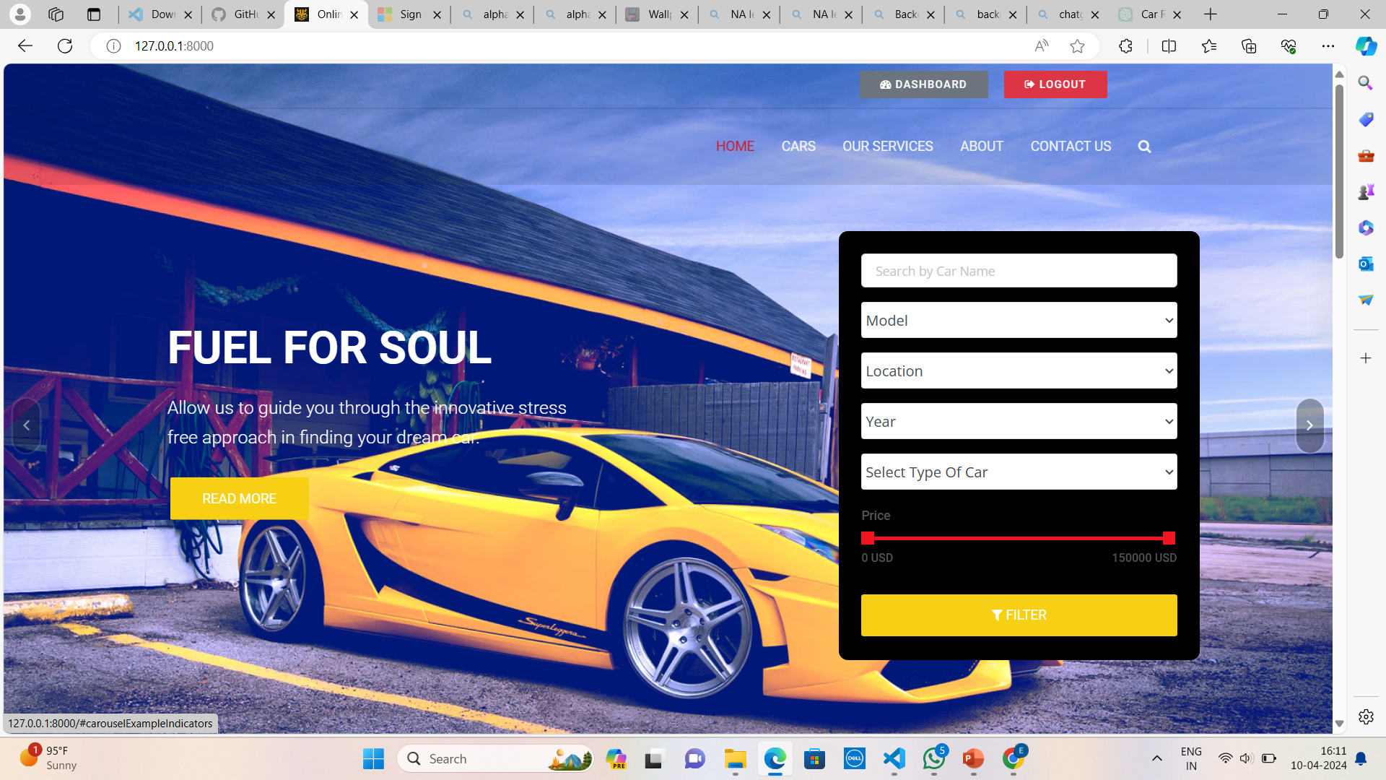
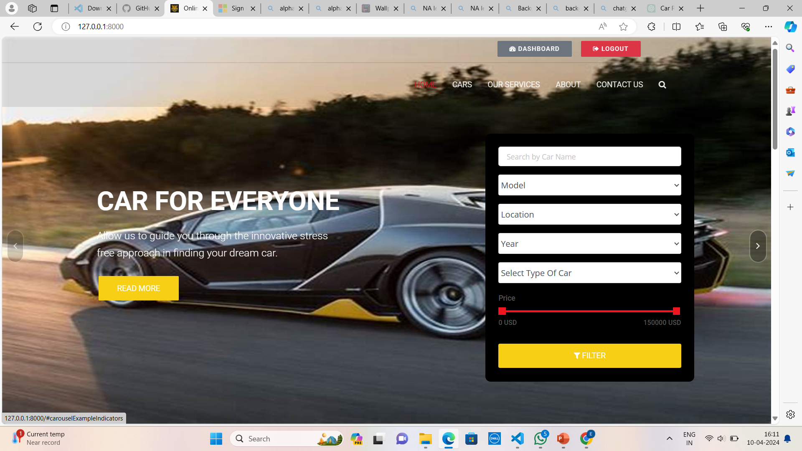
Homepage

Slide 12
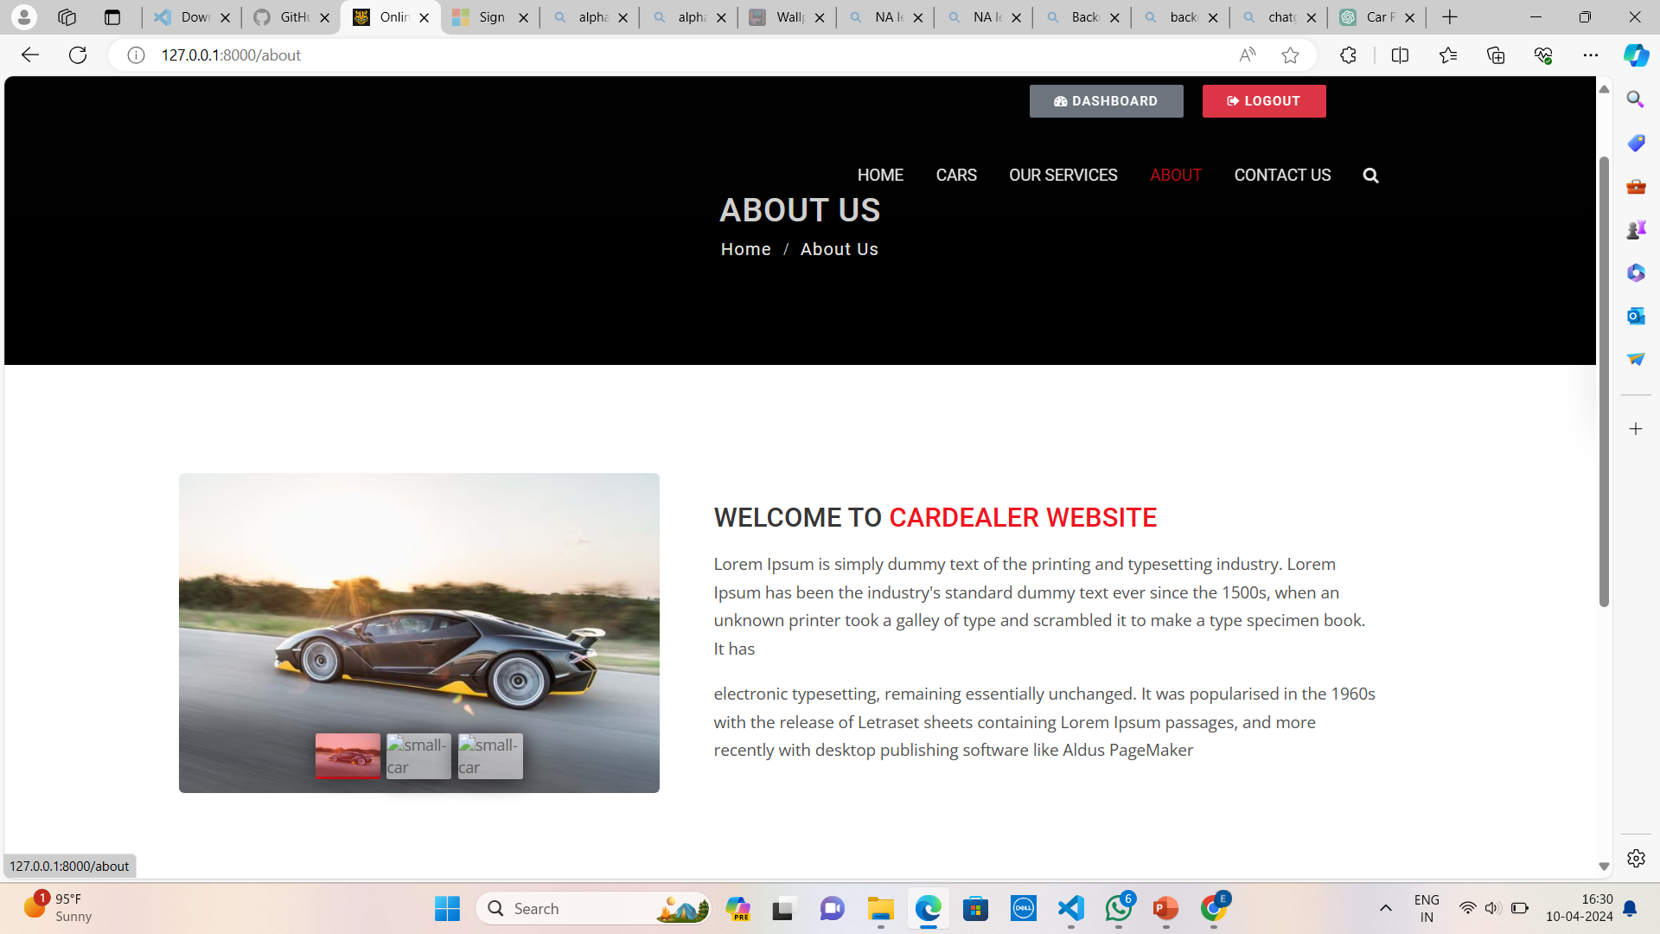
About-Us-Page

Slide 13
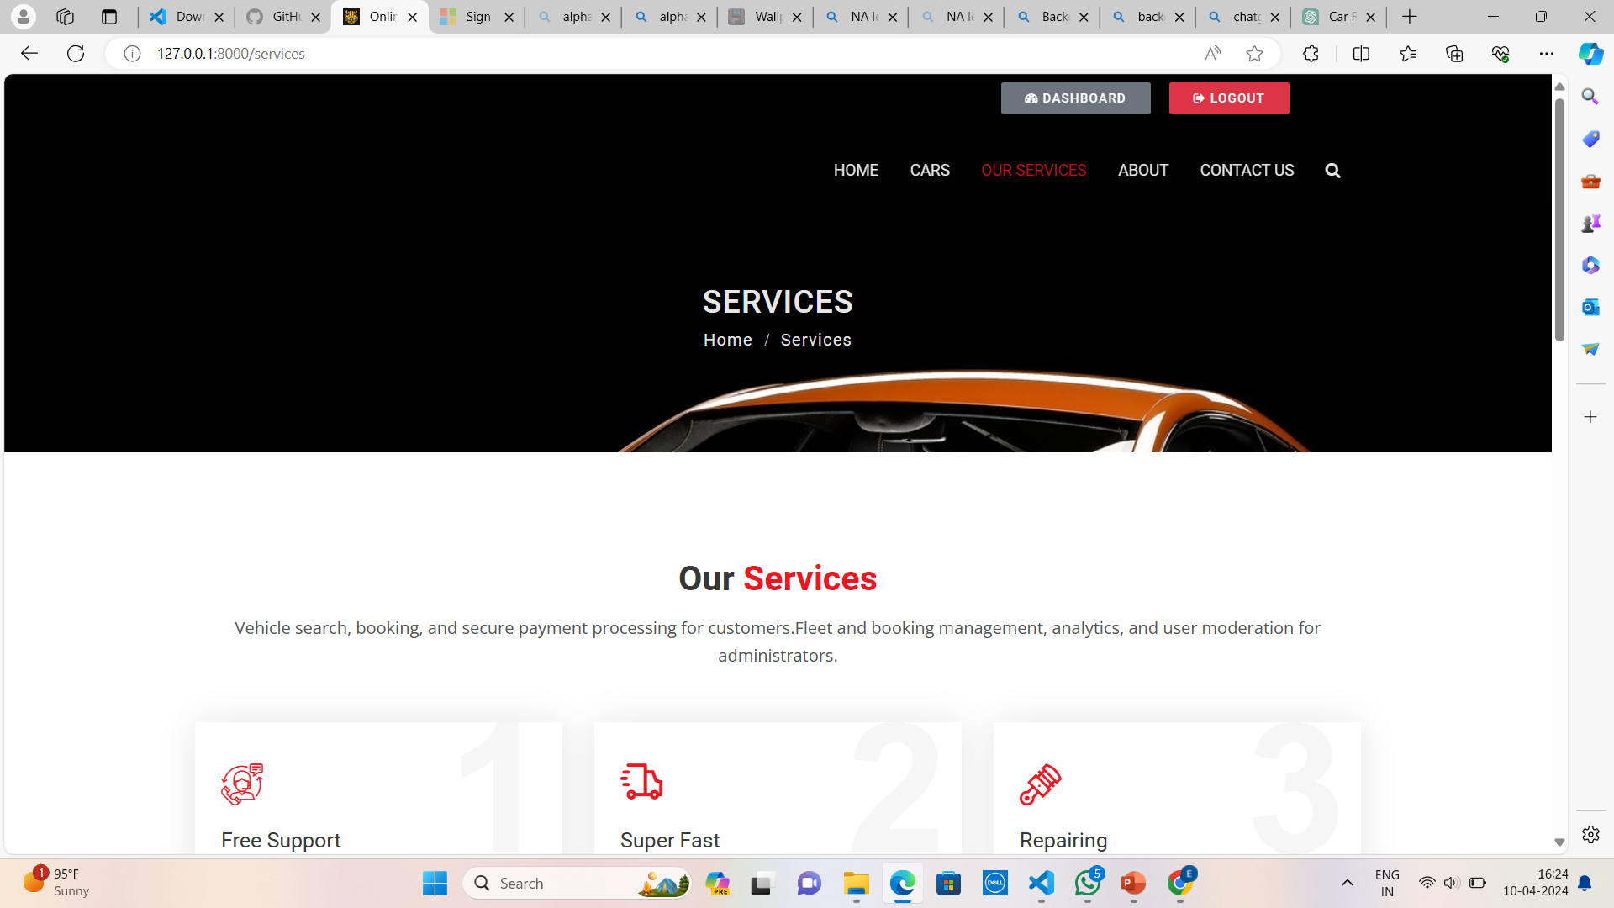
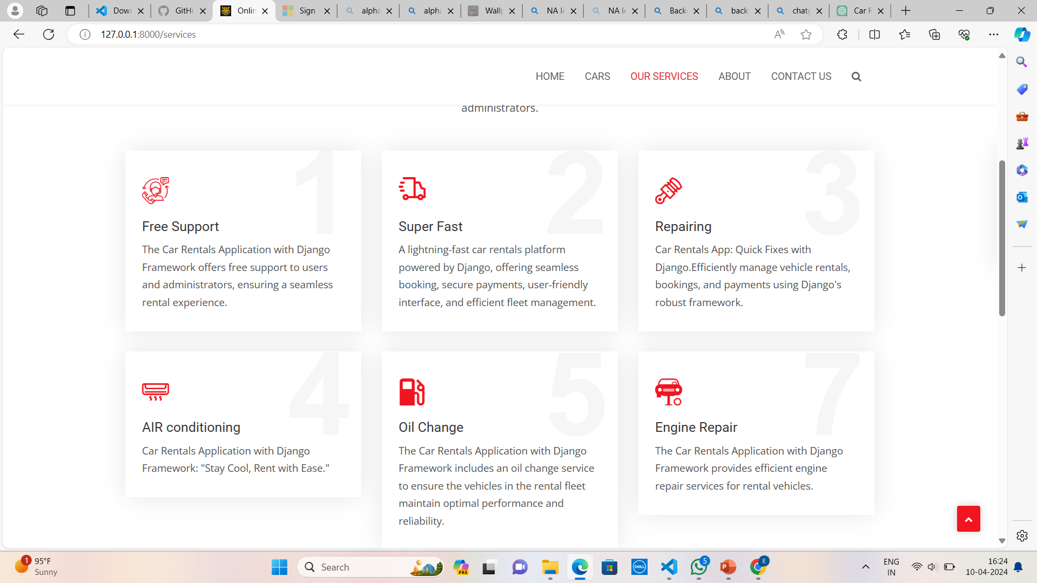
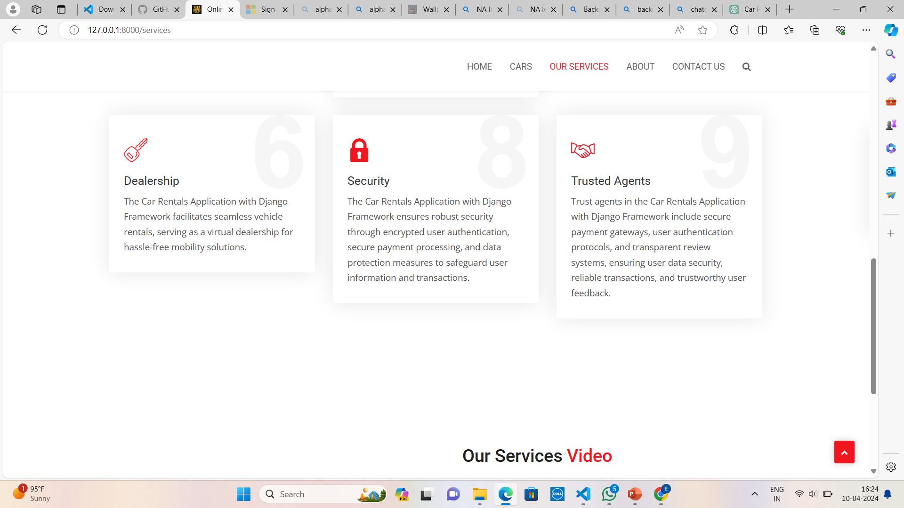
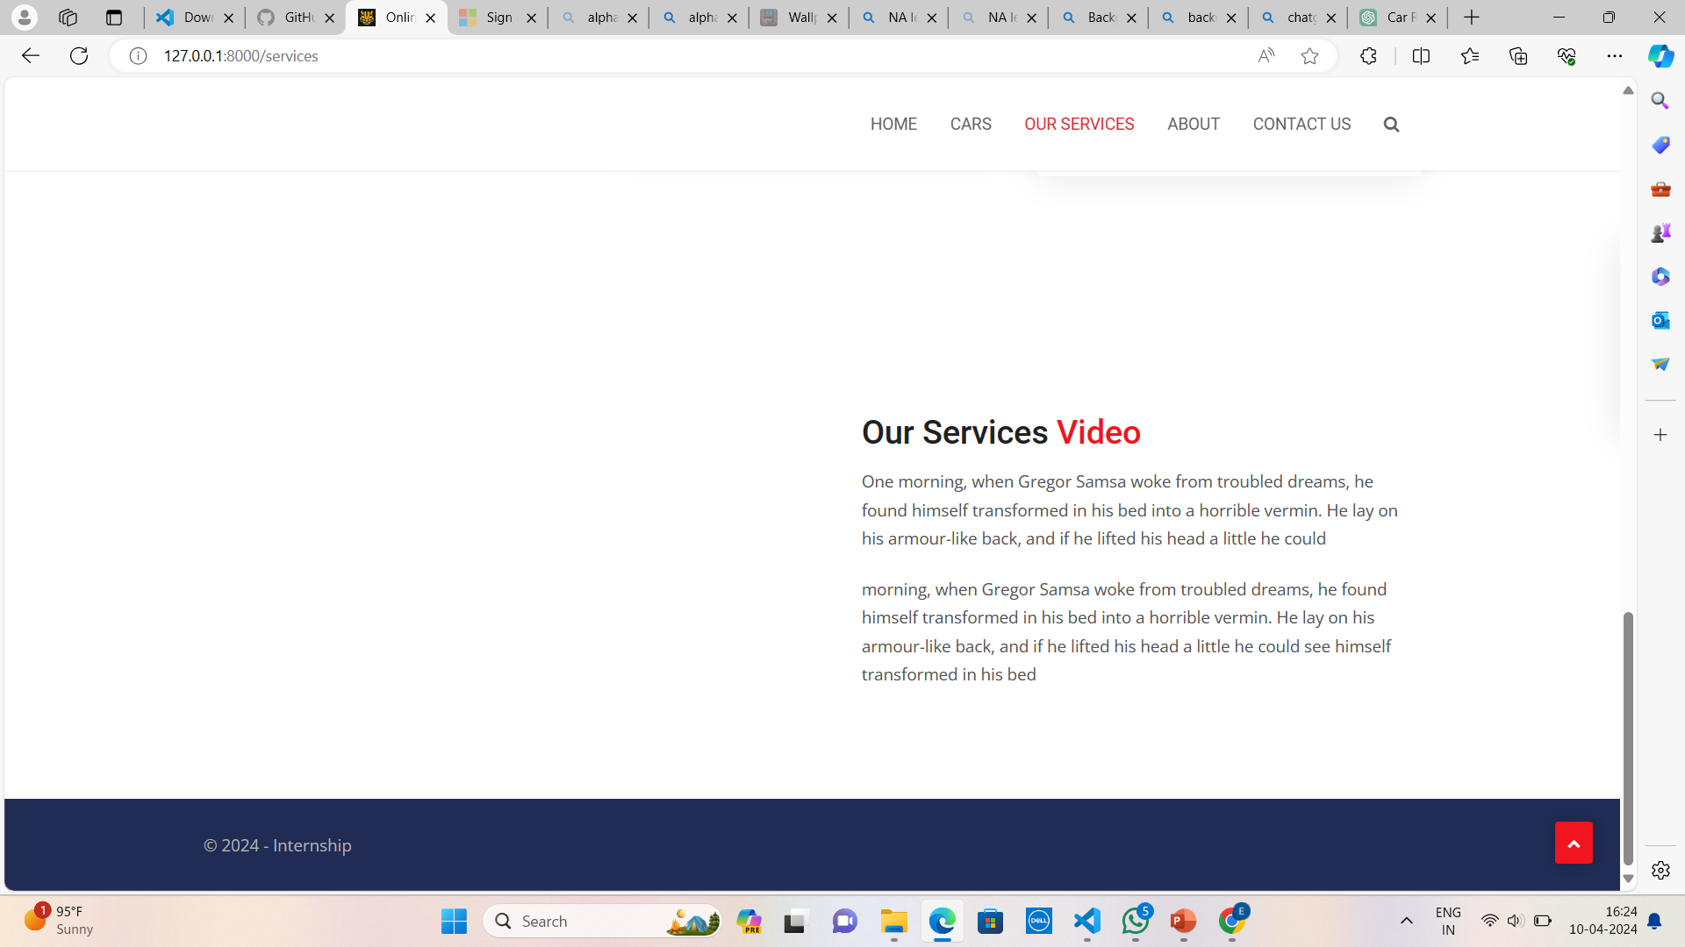
Service-Page

Slide 14
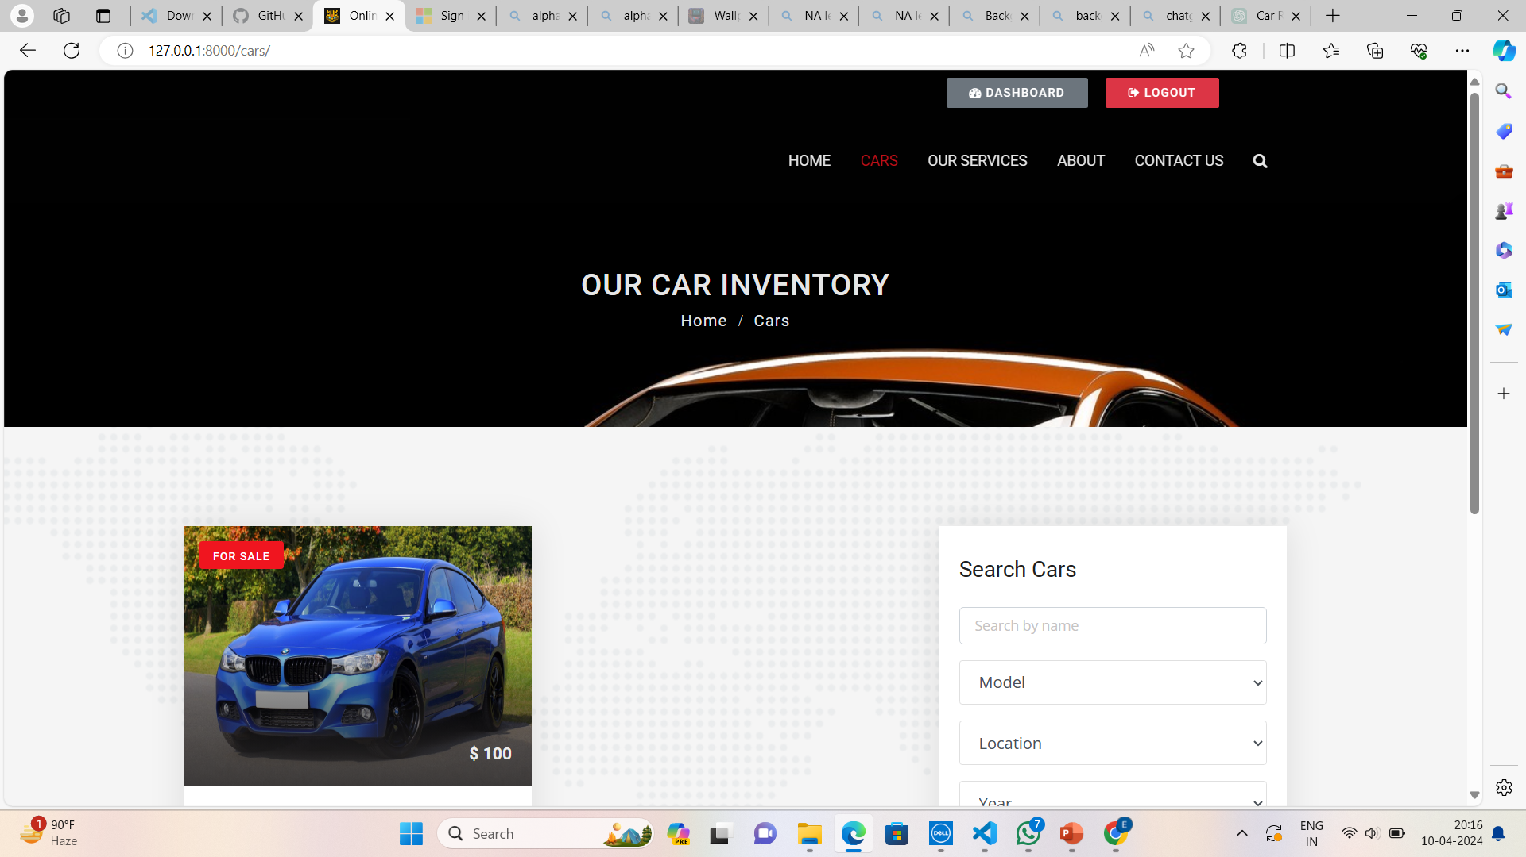
Our car

Slide 15
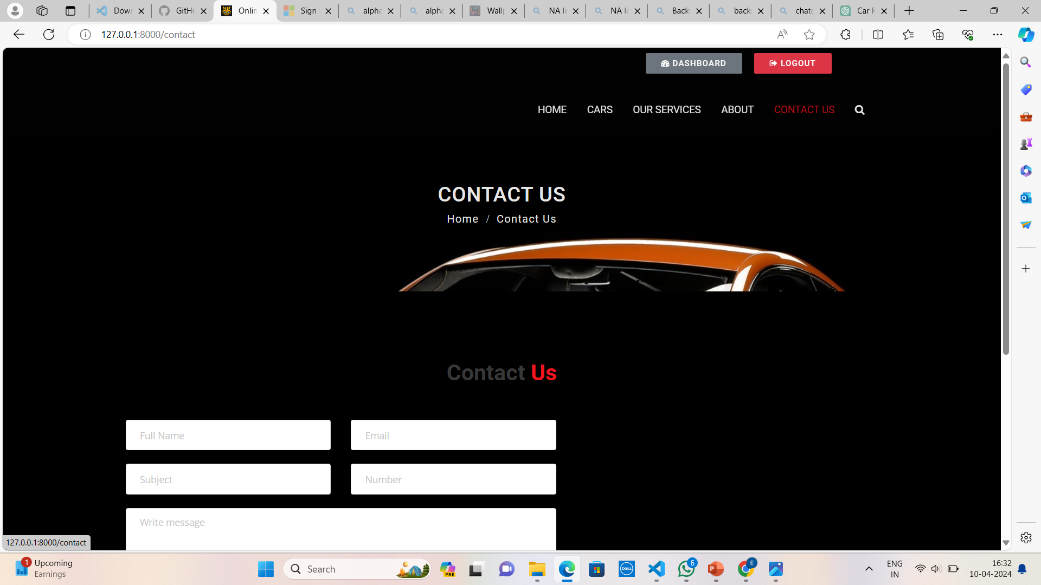
CONTACT US

Slide 16
Future Enhancements: In the future, the Car Rentals Application built with Django Framework can undergo several enhancements to further improve its functionality, user experience, and competitiveness in the car rental industry. These enhancements could include: 1.Integration with Vehicle Tracking Systems: Implement integration with GPS-based vehicle tracking systems to provide real-time location tracking for rental vehicles. 2.Advanced Pricing and Discount Management: Develop dynamic pricing algorithms to adjust rental prices based on factors such as demand, vehicle availability, and seasonal trends. 3.Mobile Application Development: Develop native mobile applications for iOS and Android platforms to complement the web-based rental platform

Slide 17
Conclusion The Car Rentals Application built with Django Framework offers a comprehensive solution to streamline the vehicle rental process for both customers and administrators. Through intuitive interfaces, secure payment processing, and efficient management tools, the application aims to enhance user experience and optimize operational efficiency in the car rental industry. By leveraging the capabilities of the Django framework, the application provides a robust foundation for developing and deploying scalable, reliable, and user-friendly web-based rental services. Key features such as vehicle search and selection, booking management, secure payment processing, and user account management empower customers to easily find, reserve, and rent vehicles according to their needs.
Source :

Slide 18
Thank You!
Notes:
Thank You !!

